Slide 1
FOODIEE SYSTEM
By
PS YESHWANTH (2010030122)
SRIKAR KANCHE (2010030474)
SUBRAMANYAM(2010030167)
P.VENKATA SAI ADITHYA REDDY(2010030434)
MENTOR’S
MR SAISDHAR, Mr. G. Madhukar Rao

Slide 2
Table of contents
INTRODUCTION
LITERATURE SURVEY
PROBLEM STATEMENT
MODULES
TOOLS
WORK ALLOCATION
CONCLUSION

Slide 3

INTRODUCTION
The People must be present condition in taken food from Hotel that means People had to compulsion of goes to Hotel.
Now the moment the Online food ordering could be called the response of the Internet to the desire for delivery food.
It is a growing trend especially in urban areas and on college campuses that allows people to order from restaurants featuring interactive menus, by use of their Internet connection.

Slide 4
LITERATURE SURVEY
S.NO | TITLE | AUTHOR | Publishing Year | Description
1 | Touchpad Based Food Ordering System Using Android Application | Kirti Bhandge, Tejas Shinde | 2015 | International Journal of Advanced Research in Computer Science Technology
2 | Implementing Customizable Online Food Ordering System Using Web Based Application | Varsha Chavan, Priya Jadhav,Snehal Korade | 2015 | International Journal of Innovative Science, Engineering Technology
3 | Digital dining in Restaurants using Android | Resham Shinde, Priyanka Thakare | 2014 | International Journal of Advance Research in Computer Science and Management Studies
4 | Digital Ordering System for Restaurant Using Android | Niranjan Jadhav, Apurva Joshi, | 2013 | International Journal of Scientific and Research Publications

Slide 5
PROBLEM STATEMENT
The main objective of the Online Food Ordering System is to manage the details of menu Category, Food, Delivery Address, Order, payment and automate the existing manual system with the help of advance computerized software so, that valuable data can be stored for longer period with easy accessing and manipulation of the same.
The registered user can access the account with valid credentials. User can surf the food item according to categories, Cash and card payment options are available to user. User can track their orders with the food details. In Online Food Ordering System Admin can handle the functionalities like add new food items, edit/delete food items, Enable/Disable the food items according to season and availability. Admin have authority to view order details and update the delivery status of food. The payment transaction and user details are also viewable to admin.

Slide 6

MODULES
We are basically dividing our project into seven modules.
Register
Login
Forget password login entry
Display menu
Product add cart
Transaction menu
Order successfully placed

Slide 7
Tools
Operating System : windows 10,11 later
Web Server : Tomcat version 10
Database server : My SQL
Runtime Environment :Java Runtime Environment 5.0
Development tools: Eclipse
Web Browser : chrome,edge,firefox,brave

Slide 8

WORK ALLOCATION
SRIKAR KANCHE : JSP CODE
YESHWANTH : DATABASES CONNECTIVETY
SUBRAMANYAM : SERVLET CODE
VENKATA SAI ADITHYA GATHERING PACKAGES AND DATABASES

Slide 9
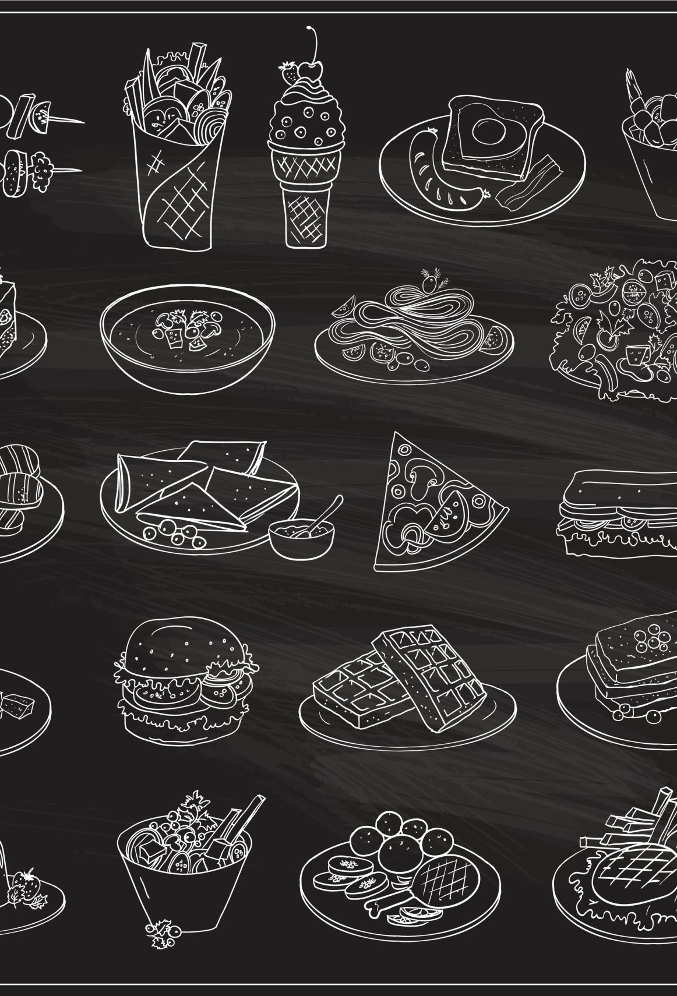
Conclusion
An online food ordering system is developed where the customers can make an order for the food and avoid the hassles of waiting for the order to be taken by the waiter. Using the application, the end users register online, read the E-menu card and select the food from the e-menu card to order food online. Once the customer selects the required food item the chef will be able to see the results on the screen and start processing the food. This application nullifies the need of a waiter or reduces the workload of the waiter. The advantage is that in a crowded restaurant there will be chances that the waiters are overloaded with orders, and they are unable to meet the requirements of the customer in a satisfactory manner. Therefore, by using this application, the users can directly place the order for food to the chef online.

Slide 10

THANK YOU

